Slide 1
ARM data-oriented metrics and diagnostics package for GCMs (ARM-Diags)
Cheng Tao, Chengzhu (Jill) Zhang and Shaocheng Xie
Lawrence Livermore National Laboratory
2023 ARM/ASR Joint User Facility and PI Meeting, Rockville, Maryland
This work was performed under the auspices of the U.S. Department of Energy by Lawrence Livermore National Laboratory under contract DE-AC52-07NA27344. Lawrence Livermore National Security, LLC. LLNL-PRES- 852738.

Slide 2
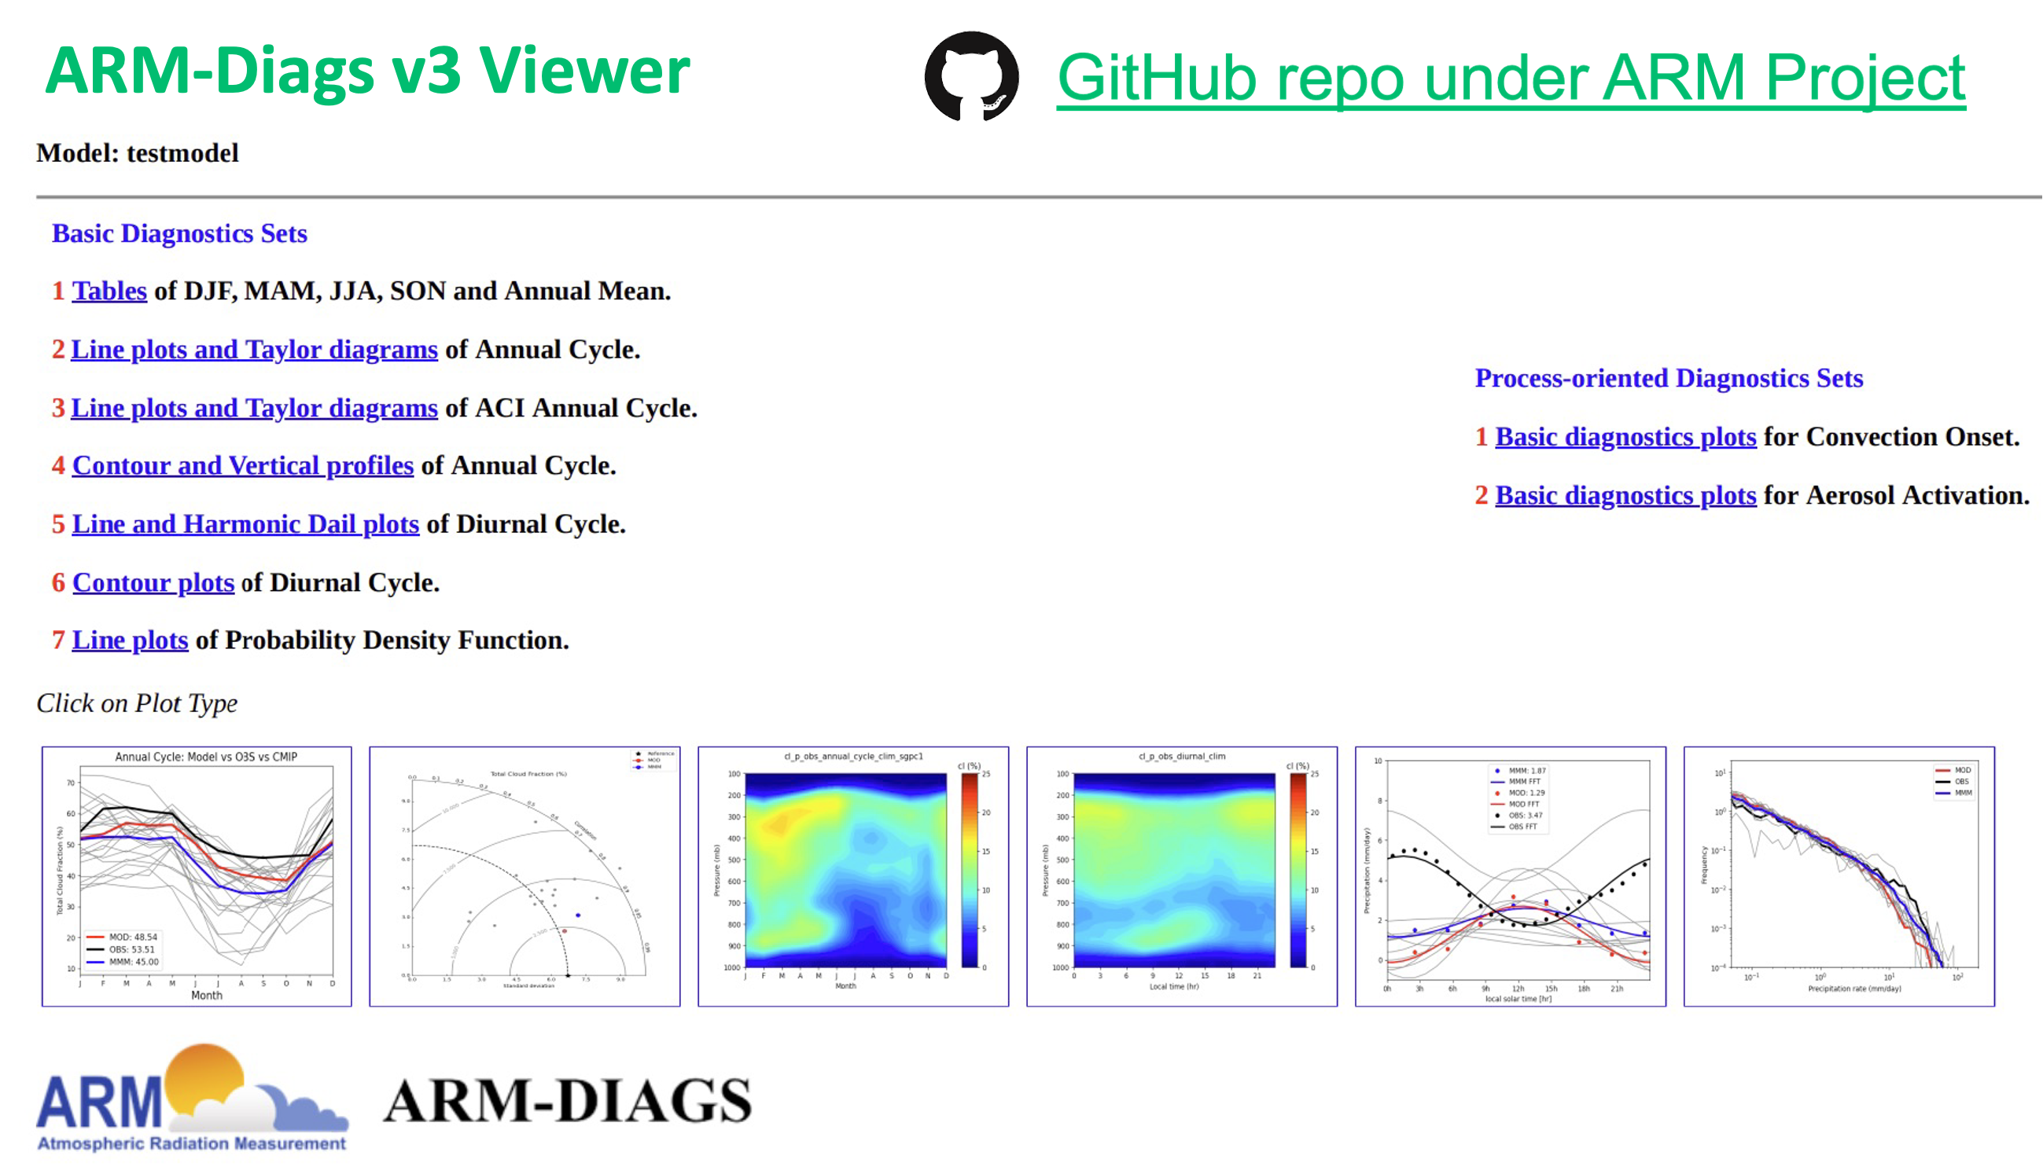
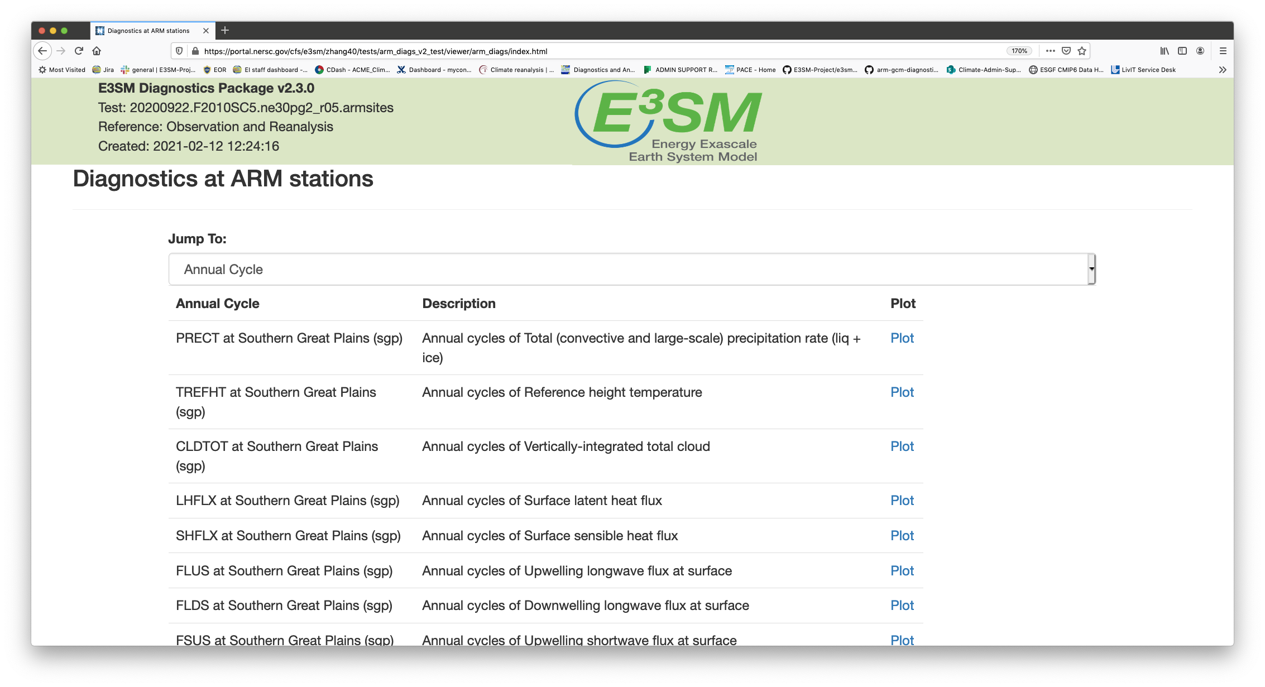
Overview
Objective: To facilitate the use of ARM ground-based in-situ measurements in climate model evaluation and model inter-comparison.
Utilize ARM high-frequency long-term continuous measurements of clouds, aerosols, radiation, and precipitation.
Provide process-oriented diagnostics to help understand model errors and improve physical parameterizations.
Python package for file I/O, metrics calculation, graphics, generating viewer, available from GitHub ARM project space.

Slide 3
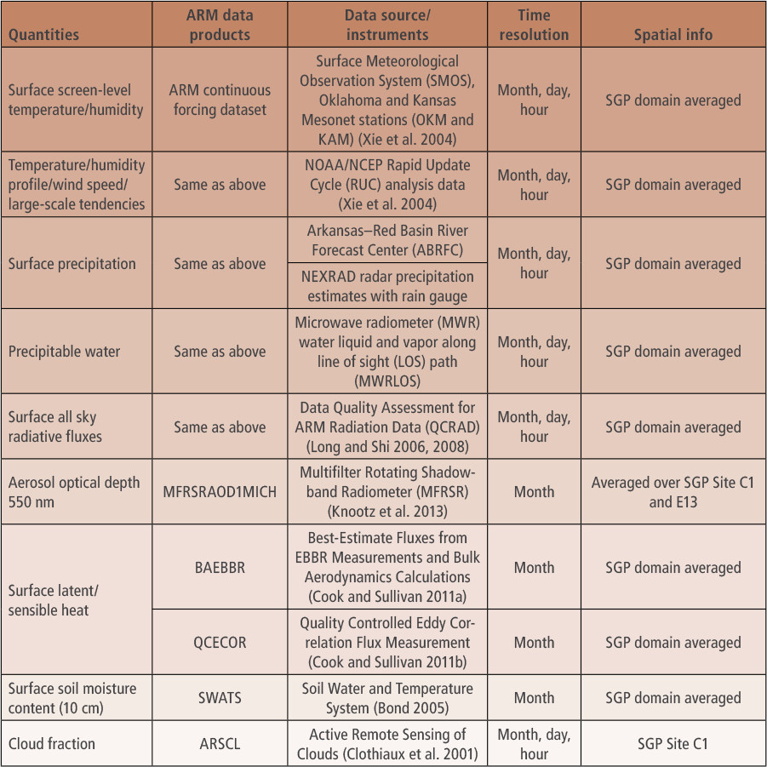
Major components
The ARM-Diags includes four major components:
A Python-based analysis program;
An ARM-based collection of mean and diurnal and seasonal cycle climatology as well as high time frequency data for process-oriented diagnostics;
A database of simulation data from models contributed to the CMIP project;
Relevant technical documentation for ARM-Diags.
Currently available for the SGP, NSA Barrow, TWP Manus, Nauru and Darwin sites, ENA and MAO sites.
Observational data derived from: VARANAL, ARMBE, ACRED, SWATS and other VAP products.
Zhang et al. (2020), BAMS.

Slide 4
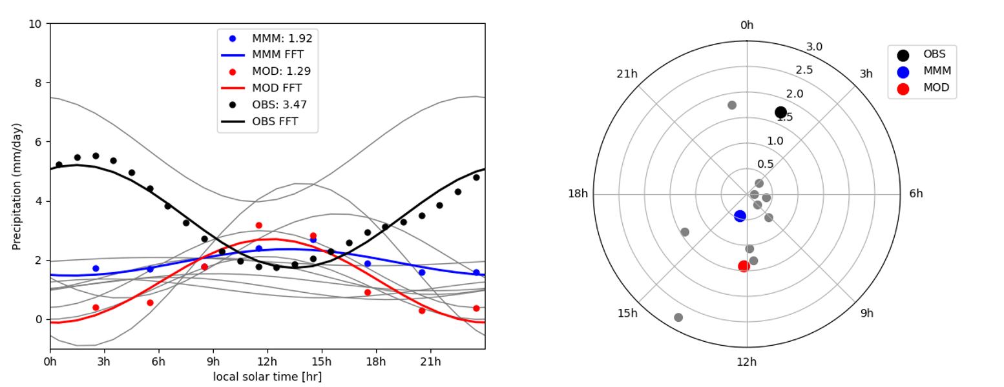
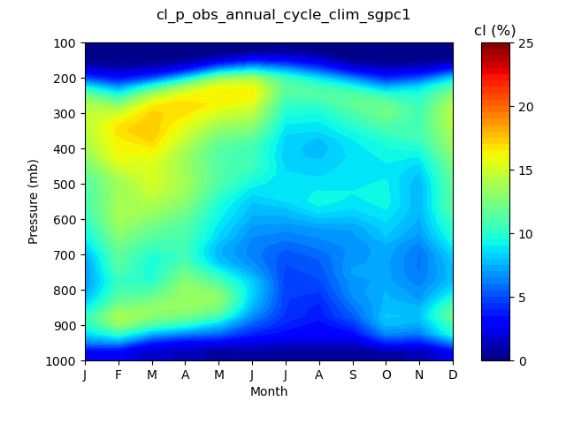
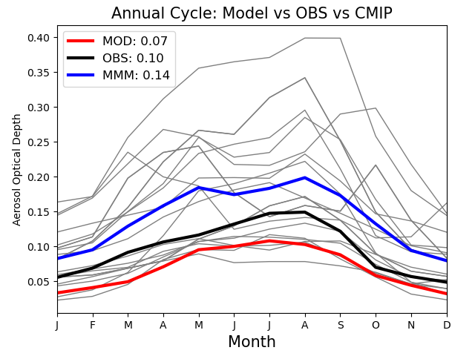
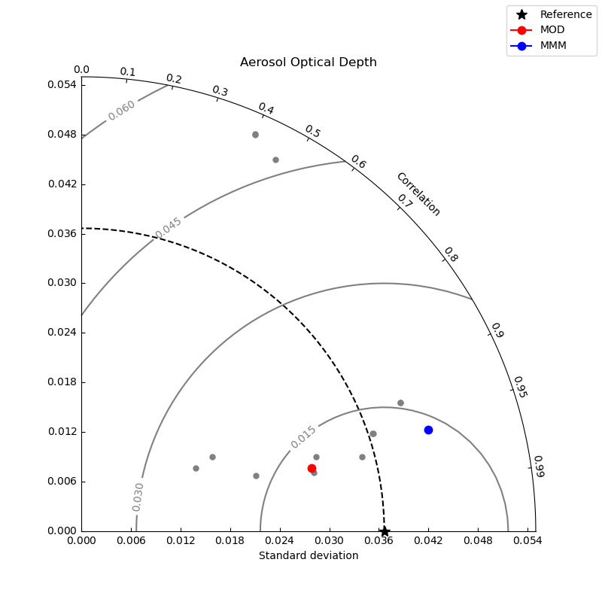
List of metrics and diagnostics (ARM-Diags v3)
A set of basic metrics tables: mean, mean bias, correlation, and root-mean-square error based on annual cycle of each variable;
Line plots and Taylor diagrams for annual cycle variability of each variable;
Contour and vertical profiles of annual cycle and diurnal cycle of cloud fraction;
Line and Harmonic dial plots of diurnal cycle of precipitation;
Probability density function (PDF) plots of precipitation rate;
Annual cycle of cloud fraction
Line plots and Taylor diagrams of Aerosol Optical Depth
Diurnal Cycle of Precipitation

Slide 5
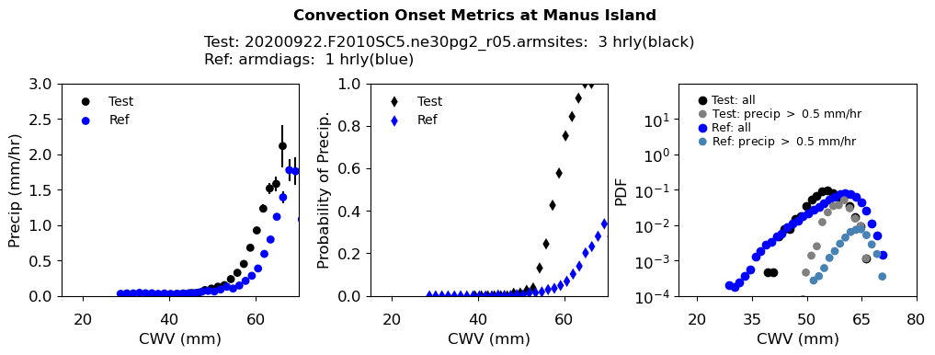
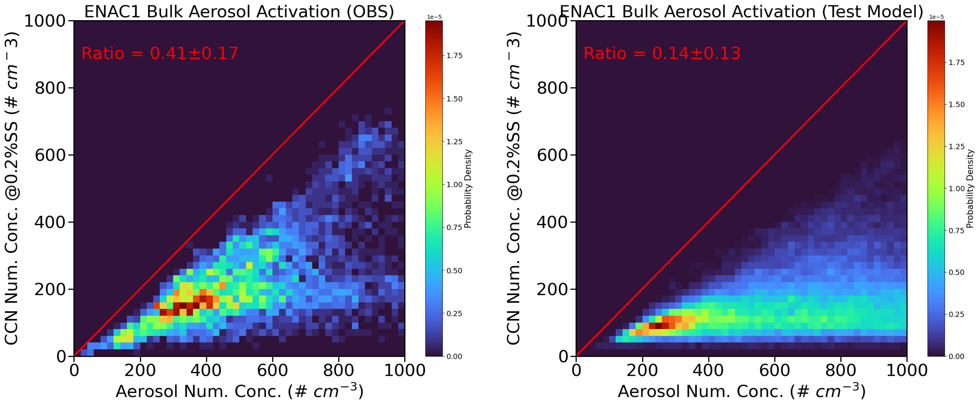
List of metrics and diagnostics (ARM-Diags v3)
Convection onset metrics showing the statistical relationship between precipitation rate and column water vapor;
Aerosol-CCN activation metrics showing the percentage distributions of how many aerosols can be activated as CCN under certain supersaturation levels.
Convection onset metrics
(contributed by UCLA)
Aerosol-CCN activation metrics
(contributed by U. of Arizona)

Slide 6
ARM-Diags: Quick Guide for Users

Slide 7
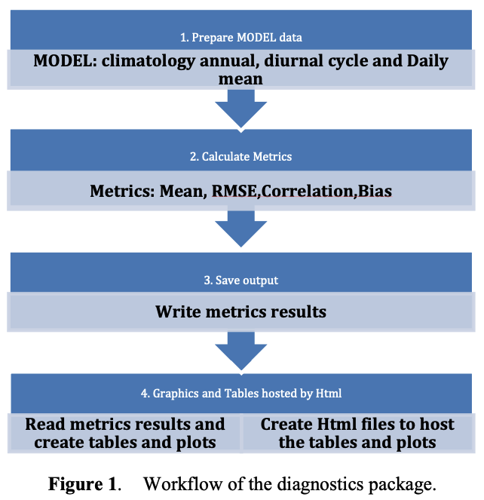
ARM-Diags: Install
For downloading data:
Go to the ARM webpage for ADCME: https://www.arm.gov/data/data-sources/adcme-123
Include both observational data sets, and climate model simulation data sets from CMIP5 and CMIP6.
For installing the package:
GitHub repository: https://github.com/ARM-DOE/arm-gcm-diagnostics
Include all Python-based analysis codes and step-by-step procedure to set up a working prototype.
Dependencies include Python libraries: cdat (*deprecated soon), matplotlib, numpy, scipy, etc. and plan to migrate towards xarray based tools.
The flowchart of creating the diagnostic results by applying the diagnostics tool

Slide 8
ARM-Diags: Set Up a Test Case
Step 1: Install the ARM-Diags on your local computer (~50 MB).
https://github.com/ARM-DOE/arm-gcm-diagnostics
Step 2: Download and place all the observation, CMIP data, test data under directories:
<Your directory>/arm_diags/observation
<Your directory>/arm_diags/cmip
<Your directory>/arm_diags/model
Step 3: Edit parameter file <basicparameter.py> to set ‘base_path’ to <Your directory> and ‘output_path’ for where the results will be saved.
Step 4: Run the package:
python arm_driver.py -p basicparameter.py

Slide 9
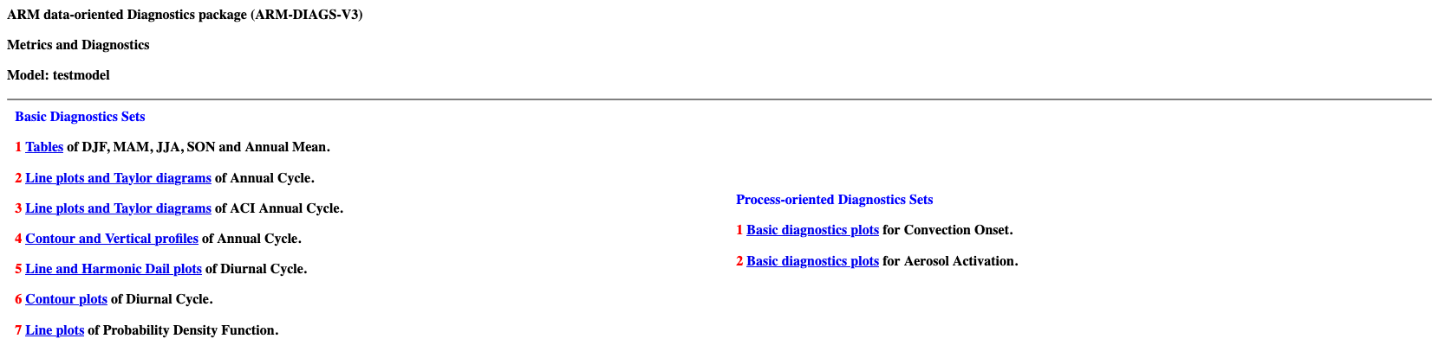
ARM-Diags: Set Up a Test Case
To view the diagnostics results:
For Mac OS:
open <Your directory>/arm_diags/case_name/html/ARM_diag.html
For Linux:
xdg-open <Your directory>/ arm_diags/case_name/html/ARM_diag.html

Slide 10
ARM-Diags: Set Up a New Case
Step 1: Install the ARM-Diags on your local computer (~50 MB).
https://github.com/ARM-DOE/arm-gcm-diagnostics
Step 2: Download and place all the observation, CMIP data, test data under directories:
<Your directory>/arm_diags/observation
<Your directory>/arm_diags/cmip
<Your directory>/arm_diags/model
Step 3: Edit parameter file <basicparameter.py> to set ‘base_path’ to <Your directory>.
Step 4: Run the package:
python arm_driver.py -p basicparameter.py
To apply this package to any CMIP output provided within our dataset, just copy the CMIP model data from
<Your directory>/ arm_diags /cmip
to
<Your directory>/ arm_diags /model

Slide 11
ARM-Diags: Set Up a New Case
Step 1: Install the ARM-Diags on your local computer (~50 MB).
https://github.com/ARM-DOE/arm-gcm-diagnostics
Step 2: Download and place all the observation, CMIP data, test data under directories:
<Your directory>/arm_diags/observation
<Your directory>/arm_diags/cmip
<Your directory>/arm_diags/model
Step 3: Edit parameter file <basicparameter.py> to set ‘base_path’ to <Your directory>.
Step 4: Run the package:
python arm_driver.py -p basicparameter.py
To apply this package to your own model output, just replace the model data in
<Your directory>/ arm_diags /model
with your own model output.
*Note that the file name should follow the test data files provided to be readable by the software package.

Slide 12
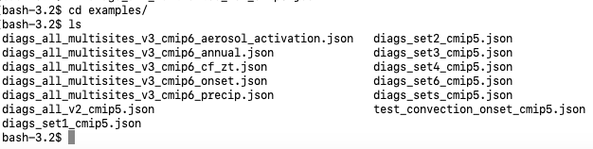
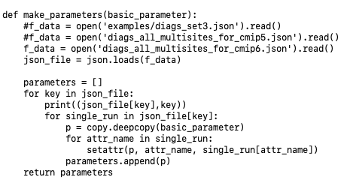
ARM-Diags: Debug mode
Run the package for certain metrics and/or ARM sites:
Check out the /examples/ folder under <Your directory>/ arm_diag
Edit the ‘XXX.json’ file in arm_driver.py to specify the metrics of interest

Slide 13
ARM-Diags: Future Plan
Expanding analysis capability by orchestrating diagnostics and metrics developed from ARM/ASR and broader community.
Collaborated with UCLA for convection onset, with U. of Arizona for aerosol cloud interaction.
Ongoing effort to include land-atmosphere coupling.
Welcome to contribute new modules!
Facilitating application of ARM-Diags in climate model evaluation, e.g. E3SM, CESM, GFDL and CMIP formatted model output, e.x:
Make modules easily portable to other analysis systems.
Update ARM-Diags results for CMIP and make them publicly available.
Technical enhancement: migrate toward using tools from xarray based Python libraries, e.g. xCDAT.
Questions and/or Feedbacks? Please contact Cheng Tao (tao4@llnl.gov).

